Slide 1
Airport Terminal Planning
Keerti Priya-103117048
Roopa G- 103117040
Sarishma Bhandari-103117086

Slide 2
Introduction

Slide 3
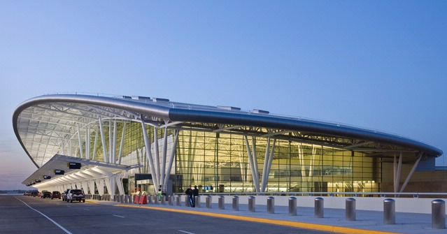
What is Airport Terminal?
Airport Terminal is a building through which passengers
change their mode of travelling, i.e. from mode of
transportation such as roadways, railways etc to airways.
Fig: Airport Terminal

Slide 4
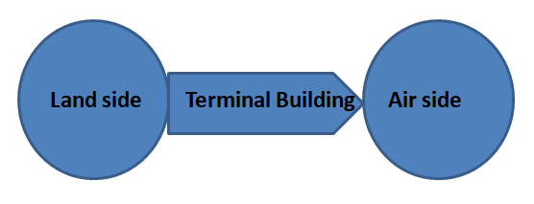
Airport terminal is one of the major component out of three
primary components of airport complex; landside, terminal
building and airside.
It connects the landside with the airside, providing sufficient
facilities for convenient movement of passengers, operation
of airlines and airport administrators.

Slide 5
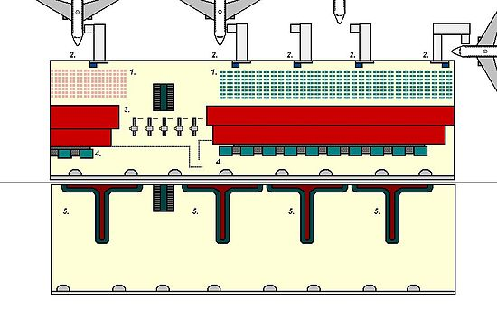
Where is it located?
A terminal building is located between airside facilities and
roadside facilities. Figure depicting a terminal building is
shown below. It contains an entry/exit point through which
passengers embark/disembark their journey and a gate
location where passengers shift from the building to the
aircraft and vice versa.
1. Departures Lounge. 2. Gates and jet bridges. 3. Security Clearance Gates. 4 Baggage Check-in. 5. Baggage Carousels

Slide 6
Designing Terminal Building
It should be designed properly to accommodate the present
air traffic along with handling 6-7% per annum growth.
There are different configurations which are adopted to
accommodate the design population of passengers, airline
staffs, airport administrations along with airport security. It
should be made with minimum construction cost, receive
maximum revenue and utilize maximum space.

Slide 7
Terminal Configuration

Slide 8
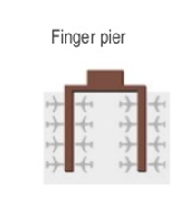
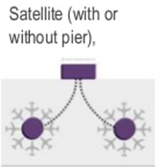
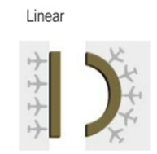
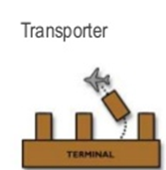
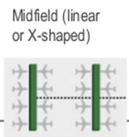
Terminal Configuration
There are five basic types of terminal configuration:-
1) Finger pier
2) Satellite (with or without pier)
3) Linear/curvilinear
4) Transporter
5) Midfield (linear or X shaped)

Slide 9
Pier/Finger Pier
1) Aircrafts are parked on both side of a concourse.
2) Aircrafts usually arranged around the axis of the pier in a perpendicular fashion.
3) Passengers are usually processes at the simple terminal location and then routed down a pier where aircraft are parked in the finger slots or gates for boarding.
4)High aircraft capacity and simplicity in design.
5) Maximise the number of aircraft parking with spaces with fewer infrastructures.

Slide 10
6) Preferable when the level of transfer traffic is low.
Disadvantages of pier/finger pier:
Long walking distances
Add constraints with the mobility of aircraft movement in the apron
Limited expansion capability
Techniques to tackle these issues:
Short finger piers
Incorporating people movers

Slide 11
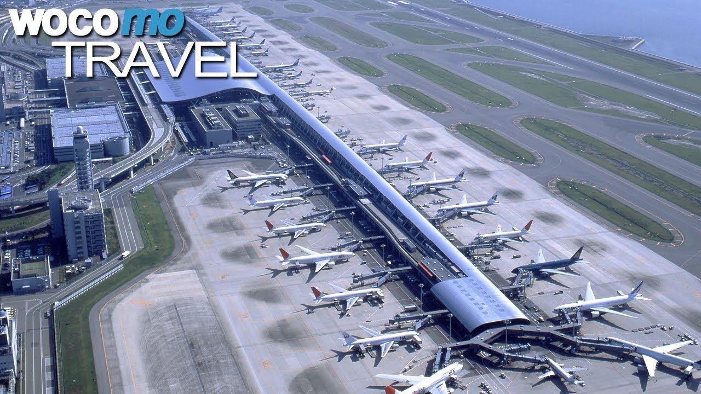
Fig: Osaka International Airport (E.g. of pier configuration)

Slide 12
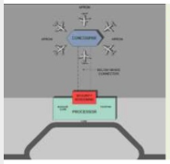
Satellite
1) Extension of T-shaped finger piers.
2) It is completely surrounded by aircraft.
3) Parked in a nose-in arrangement around the satellite.
4) A single terminal to process passengers.
5) It works well for heavy activity airport and large percentage if connecting passengers.

Slide 13
6) Connected to this are numerous concourses that lead to one or more satellite structures.
7) Passenger processing is handled in a separate terminal facility.
Disadvantages:
Requires high technology, underground transportation system.
High capital, maintenance and operating cost
Increases minimum connecting times.

Slide 14
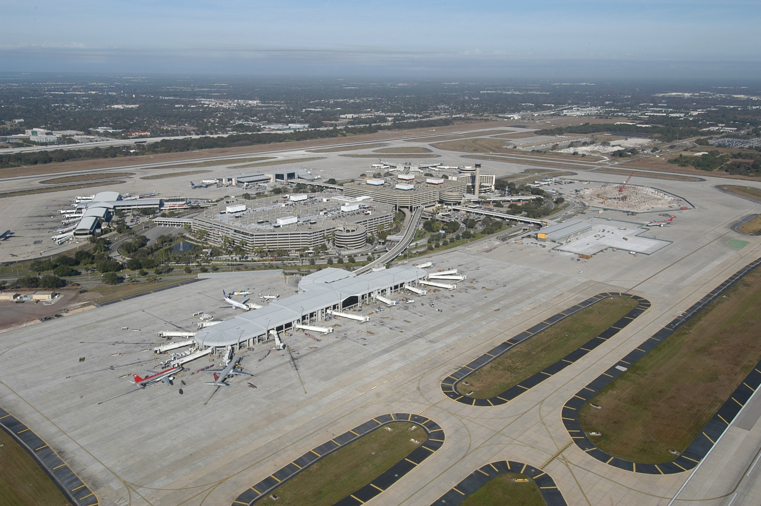
Fig: Tampa International Airport (E.g. of Satellite configuration)

Slide 15
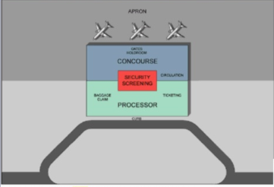
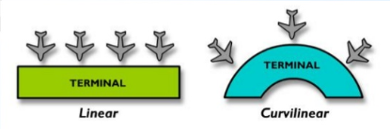
Linear/Curvilinear
1) Simple and most straight-forward.
2) Simple organizational principles.
3) Consists of a single passenger processing area.
4) Primarily appropriate for low- activity O&P airports.
5) Centralized passenger processing.

Slide 16
Disadvantages:
Longer walking distances for transfer of passengers
Primarily applicable for low activity airports.
Requires duplication of terminal facilities/amenities.

Slide 17
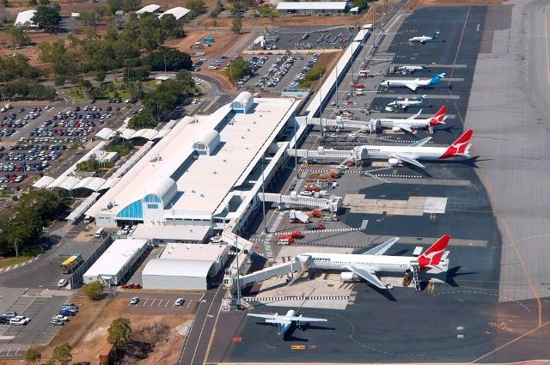
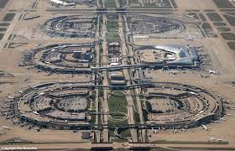
Darwin International Airport
Dallas forth-worth International Airport
Fig: E.g. of Linear Configuration

Slide 18
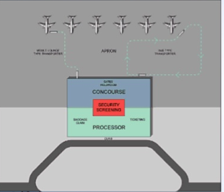
Transporter
1) It provides a complete separation of passenger facilities from those required to service and maintain the aircraft.
2) Aircraft and a/c servicing facilities are remotely located from the terminal.
3) Passengers are transported to and from the building to the parked airplane.

Slide 19
4) Specially designed buses carry passengers between the terminal and the aircraft.
5) Airplane taxiing time to and from the runway is decreased.
6) It reduces the amount of aircraft engine noise around the terminal.
Disadvantages:
High capital, maintenance and operating costs.
Increased minimum connecting times.
Inconvenient delays for short haul passengers.

Slide 20
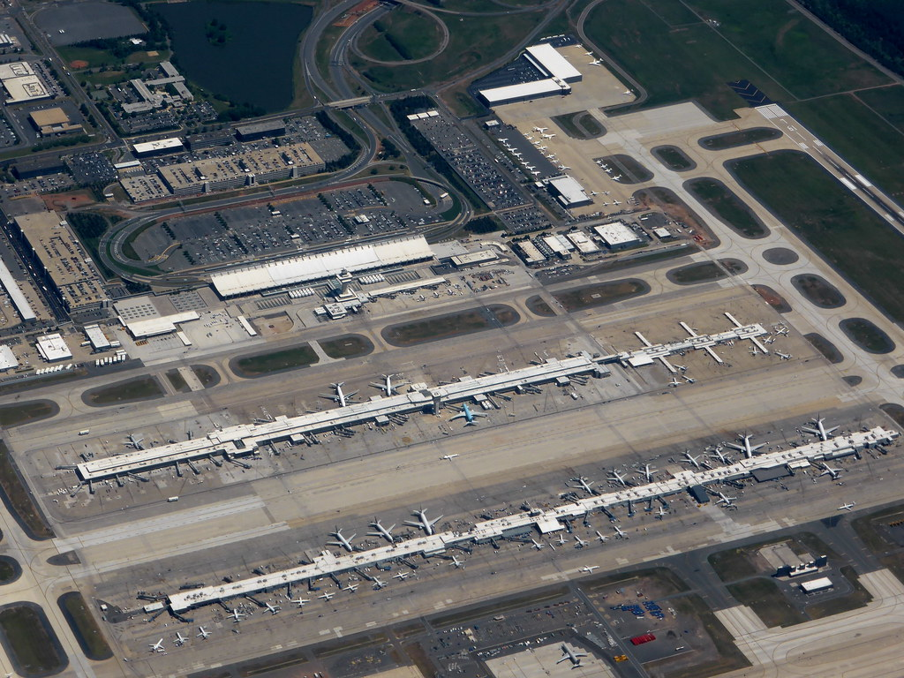
Fig: E.g. of Transporter Configuration Washington/Dulles Airport

Slide 21
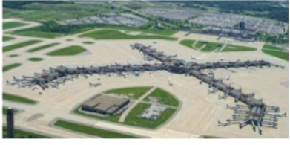
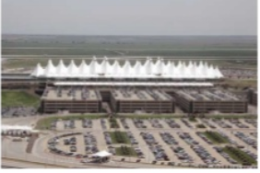
Midfield Concourse
1)Independent passenger buildings.
2) Typically between two parallel runways and separated from the other passenger buildings by major taxiways.
3) Two basic shapes: linear and x-shaped.

Slide 22
Hybrid Configurations
1) Combination of different configuration types.
2) Provide large passengers processing capacity.
3) Permit centralization of facilities and amenities.
4) Manpower saving in the centralization system.
5) Facilitate flow and orientation of passengers.
6) Reasonable check-in and close-out times.
7) Meet variety of existing needs.
8) Adapt easily to future needs.
9) Maximize quality of service.

Slide 23
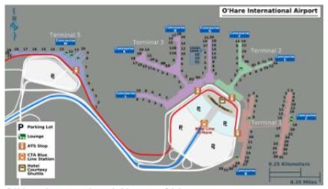
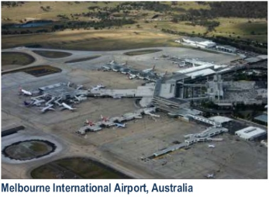
Fig: E.g. of Hybrid Configuration

Slide 24
Evaluation of Configuration
Many factors are involved in deciding which configuration is
better.
The key considerations in evaluation are walking
distances, traffic pattern, flexibility, priorities of stakeholders,
the site, aircraft taxiing around the buildings.
The selected
configuration should reduce major operational problems and
financial loss.

Slide 25
Overall design of Airport Terminal

Slide 26
Major design considerations
Some key factors to build efficient and attractive terminal
buildings include;
Passenger Flow
Level of Service
Walking Distance
Processing time
Efficient Public Transportation
Way finding
Security

Slide 27
Terminal Building Planning Principles
Some basic rules to be adopted for terminal building planning
are;
1) Passengers walking distance should not be more than 180m from surface transportation to their boarding into the aircraft.
2) The Airline passengers should not have to carry the baggage by more than 22.5m from the road transportation to the check-in-point.
3) The maximum check-in-time should not exceed 3 minutes.
4) Passengers should be able to check-in without waiting.

Slide 28
Design of Passenger Building
Design standards for any part of a passenger building is not
universal.
Efficient design requires careful consideration of
the following:
1) Sharing of facilities: Sharing of multifunctional and common used facilities reduces the overall design load and provide flexibility.

Slide 29
2) Performance objectives: The operations of the airport and aircrafts should be economic and efficient and the quality of the services provided should be good.
3) Management of operations: Daily activities and any problems that might occur inside the airport should be properly managed.

Slide 30
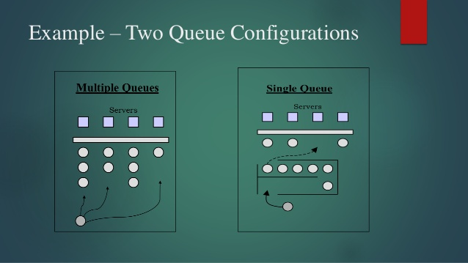
Queues in an airport!!!
After passengers are inside the terminal building, they have to
follow many operations such as check-in, security check etc.
For this they have to stand in a queue.
The thumb rule is 0.6m per person. Also, Snake queue is
better compared to straight queue because it more
efficient due to wise use of space.

Slide 31
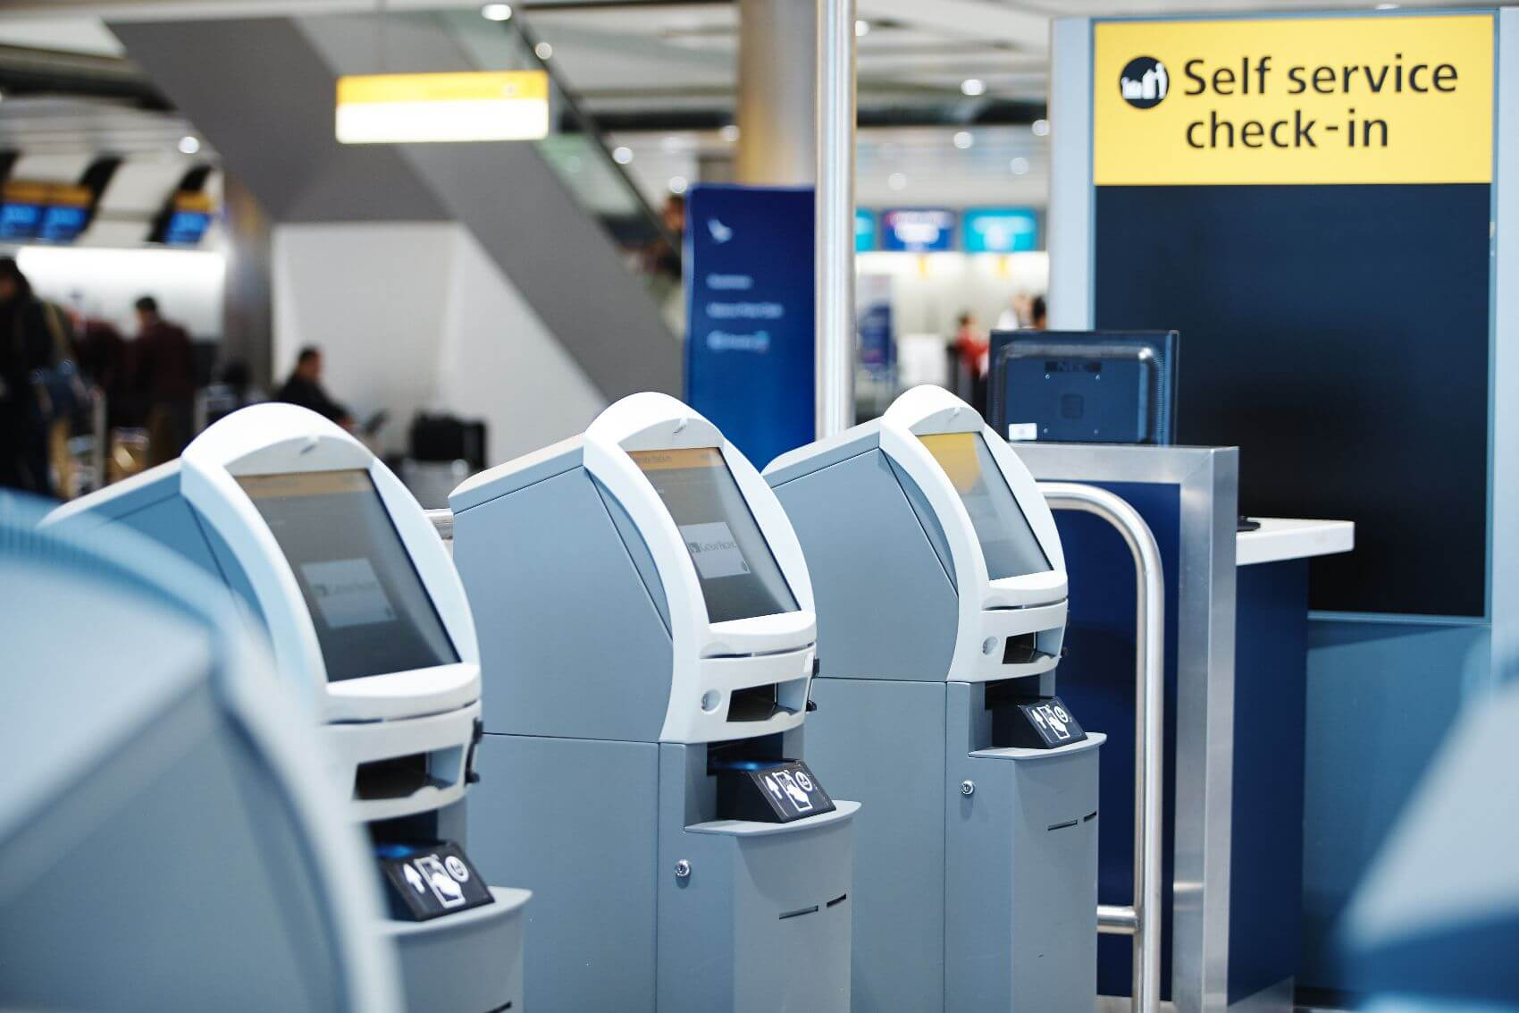
Check-in-facilities
Airport Check-in are service counters found at commercial
airports handling commercial air travel. Standards are
changing. Nowadays, electronic ticketing and self checking
reduces process time.

Slide 32
IATA Checkpoint of the future
The International Air Transport Association (IATA) has unveiled
the first mock-up of the Checkpoint of the Future, which is
designed to improve the passengers’ airport experience.
The Checkpoint of the Future is aimed at ending the ‘one-size-fits-all’ approach to airport security. Instead, based on a biometric identifier in the passport or other travel document, passengers will be directed to one of three lanes, ‘Known Traveler’, ‘Normal’ or ‘Enhanced Security’.

Slide 33
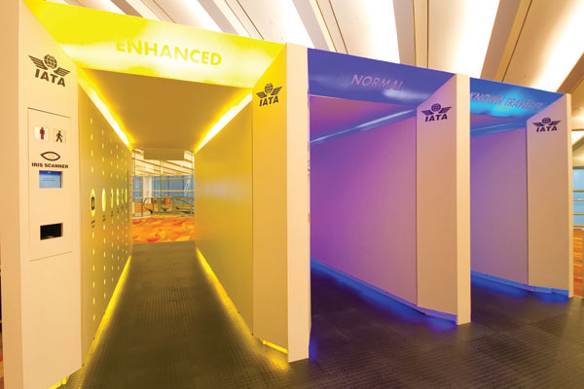
Fig: IATA checkpoint of the future

Slide 34

Security and Border Check points
It is the most important aspect of airport operations. Because
of the extreme violent terrorist event that happened in the
United States, this has led to dramatic changes in the
operation of terminals.

Slide 35
Baggage handling system
A type of conveyor system is installed in airports that
transports checked luggage. An incidence had occurred in
Heathrow airport when passengers were unable to check-in
baggage and 68 flights had to be cancelled.
Transporting the baggage safely to the destination is also one
of the most important task of the airport system.

Slide 36
Passenger Terminal Design principles
A more or less standard process has evolved over the years
for designing passenger terminals at airports. It consists of
four steps:
1) Forecasting traffic levels for peak hours;
2) Specification of level-of-service (LOS) standards;
3) Flow Analysis and determination of space requirements 4) Configuration of server and space.

Slide 37
Forecasting
The basic concept of forecasting is to estimate past trends and
design accordingly. To produce peak-hour demand scenarios
for the design day we use the following;
Design Day= Average week day of the peak month
It will have 15 to 20 percent variation with real data. Also
forecasting is unreliable/uncertain because of the constantly
changing situation.

Slide 38
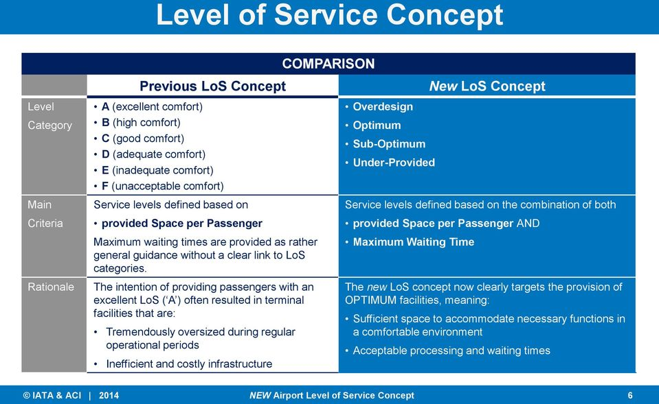
Specification of LoS(Level of Service)
These standards provide the basis for translating the
forecasts into an architectural program. LOS is higher when
passengers have more space

Slide 39
New LOS concept
When planning terminal processing facilities and corresponding
passenger queuing areas, two important variables jointly dictate
the new LOS;
Minimum Space
Maximum Waiting time
The new LOS framework is reflected in a space-time concept to
be used for defining the LOS at processing facilities and
corresponding waiting area.

Slide 40
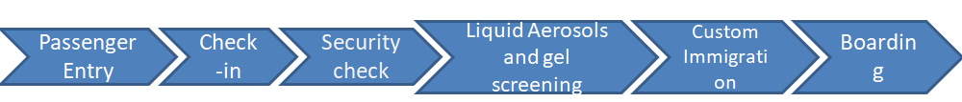
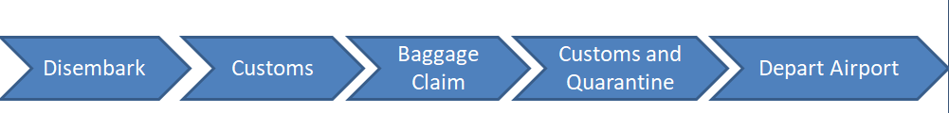
Passenger Flow
The passenger flow in the terminal can be subdivided in three
sub- processes. They are departure, arrival and transit.
Departure passenger activities include:
Arrival Passenger activities include:

Slide 41
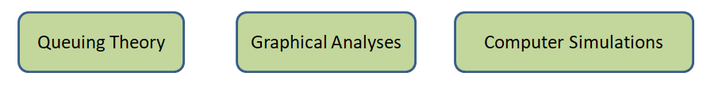
Flow Analysis
For simulation, a Cast Terminal is used in which a multi-agent
simulator is used to analyze various terminal layouts and
strategies to determine the number of facilities required.
According to the results we can optimize the Capabilities in
the early planning stages.

Slide 42
Configuration of Space requirements
The formulas for translating number of traffic into space
requirement is arithmetically simple.
Design Load for an Activity
- Depend on design peak hour/ design hour
- Airport facilities are designed to accommodate the loads
Level of Service (LoS)
LoS standard ‘C’ is generally used.
• LoS ‘C’ for design year is LoS ‘A’ at the opening time.
Dwell Time
• Typical length of time passengers stay in a waiting for service. • It indicates how fast a space can be reused by another passenger.

Slide 43
Terminal building in Indian Airports
In India, design of the terminal is derived from the traditional
form of local art and culture of the particular state in which
the airport is located.
Arriving and departing passengers will sense the identity and
reference of the place. The building will be provided with
aesthetically appealing and soothing interior decoration along
with modern design.

Slide 44
Chennai International Airport
The design of the terminal is derived from the traditional form of
local art and culture especially the traditional costume of
Bharatanatyam dance form. It can be felt in the dynamic roof
form which reflects the movement and lightness of ripples in a
fabric. This gently curved structure unifies all the terminals of the
airport and gives it an integrated look.
Passenger terminal 1 and 3 are linear configuration.

Slide 45
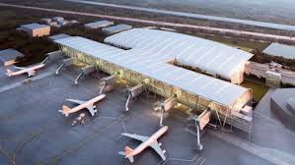
To cope with the passenger traffic, two new terminals,
namely T2 and one satellite terminal, are under
construction. Once completed, it will be India's first
airport to have a satellite terminal.

Slide 46
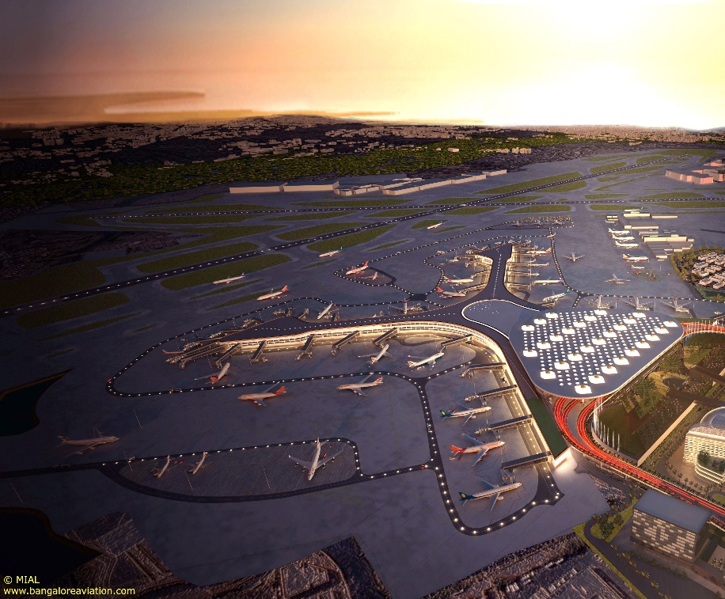
Chhatrapati Shivaji Maharaj International Airport, Mumbai:
Old terminal 2 used a semicircular terminal, with aircraft parked on one side and cars on the other.
It has got two passenger terminals.
Terminal 2 has got hybrid configuration.

Slide 47
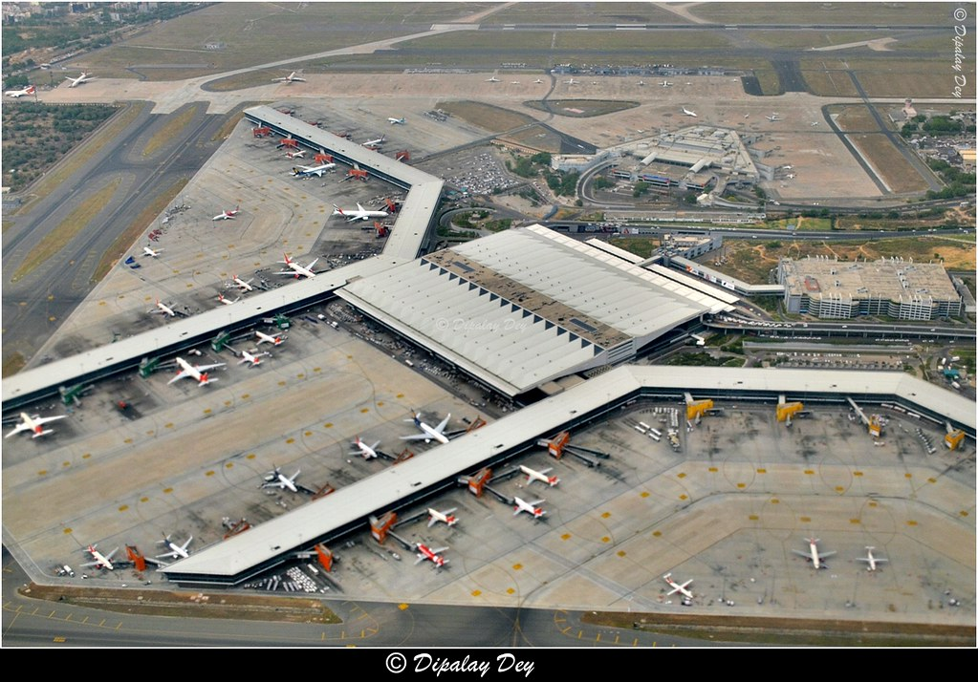
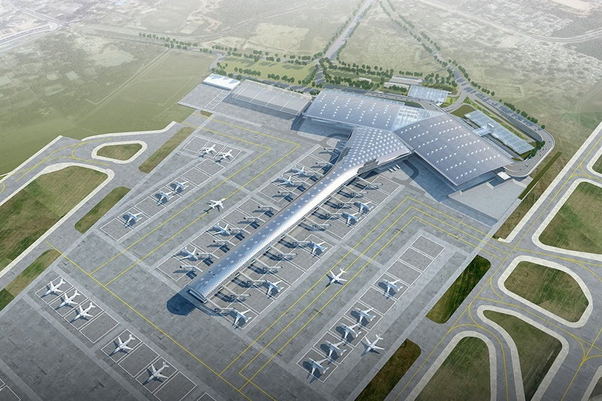
Indira Gandhi International Airport, Delhi
It is the busiest airport in India in terms of passenger traffic
since 2009. It has 3 passenger terminals. It has got pier/
finger pier configuration and hybrid configuration.

Slide 48
Evolution of airport terminal !!!
Earlier airport consisted of only one terminal and
passengers would have either walked or took a small bus to
the aircraft. All the facilities such as ticketing was limited to
paper works. But now, because of population growth,
passengers using the airport facilities have increased, also
with recent terrorism attacks the security is very tight and its
compulsory for passengers to go through clearance zones
before boarding the aircraft.

Slide 49
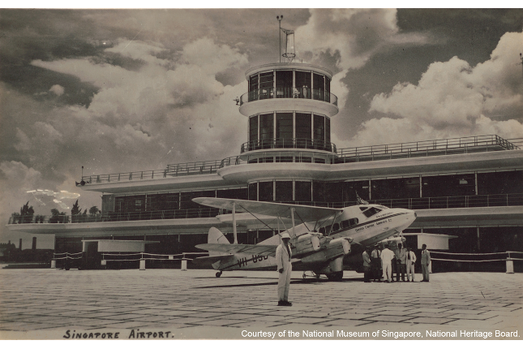
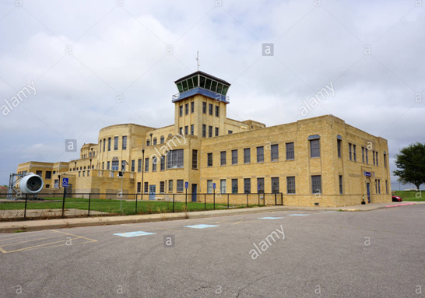
Old Airport Terminals
Fig: conventional unit terminal airport building

Slide 50
Modern Day Airport!!!
Nowadays the modern airport has all the amenities required
for a comfortable travelling ranging from cafes and
restaurants, sleeping pods and even airport hotel as shown in
the next slide!!
Many design philosophies are now being implemented in
order to cater the rapidly growing population and for utilizing
the maximum space.
Due to technological advancement, now passengers need not
rely on papers but rather everything is available in electronic
forms.

Slide 51
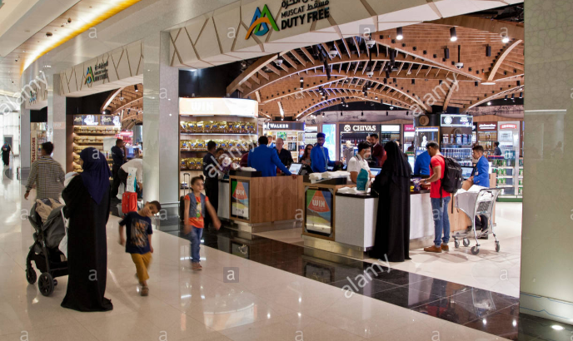
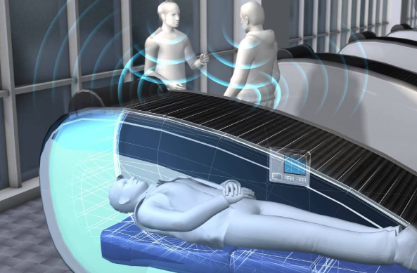

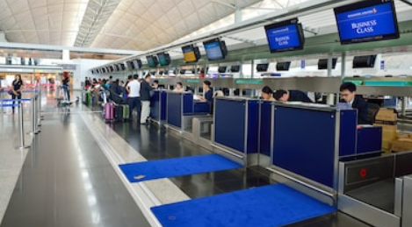
Fig: Amenities provided in modern day Airport Terminal

Slide 52
Also the development in structural theories has helped
engineers to make large structures capable of withstanding
huge loads even seismic loads.
Before safety wasn’t considered while designing but now
safety plays the most important role while constructing any
type of structure.
While designing all the forces the structure has to withstand
and will have to with stand is studied and constructed
accordingly.
Some pictures of the modern day airport are shown in the
next slide.

Slide 53
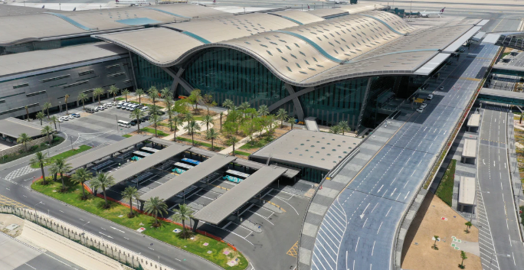
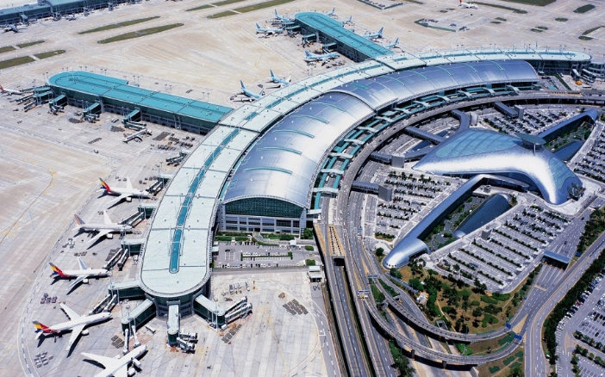
Fig: Modern Day Airport Terminal

Slide 54
Name/Roll Number | Contribution
Keerthi Priya L/ 103117048 Gollapalli Roopa/ 103117040 Sarishma Bhandari/ 103117086 | Collected materials and studied basics on different types of terminal configuration, explored materials on three of the most important airports in India with different configurations Collected materials on overall design of passenger terminal and passenger terminal design principles and studied how designs can be efficient and better Collected materials related to the introduction and how airport has evolved in the past few decades. Proofreading of all the slides in the ppt.

Slide 55
Thank you

